Slide 1
Behavioral synchrony
You are about to watch a short video clip, depicting a social interaction.
Behavioral synchrony is an important components of social interactions.
Behavioral synchrony in an interaction is when the figures are coordinated, attentive, communicate with each other or move together in coordination.
The context and type of emotion (which may be positive or negative) do not affect the level of synchrony!
Figures may be highly synchronized in situations such as argument, dispute or disagreement, which are accompanied with negative emotions.

Slide 2
Next, we will present you few examples:

Slide 3
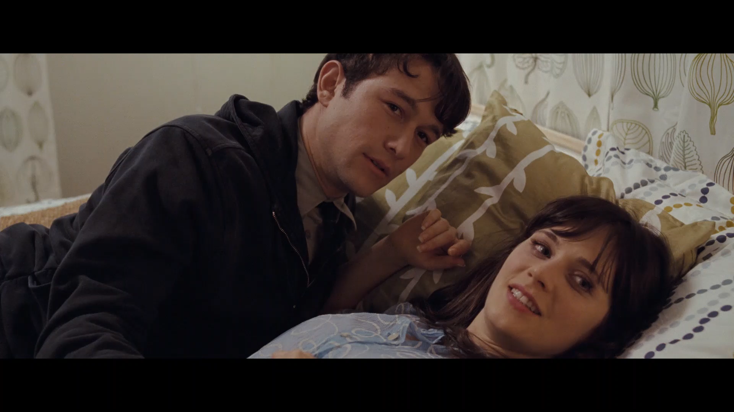

Slide 4
In this video clip there was high level of behavioral synchrony: the figures attended each other, understood the other figure and responded accurately by gaze, physical gestures (such as smile, leaning forward) and there was mutual exchange of information.

Slide 5
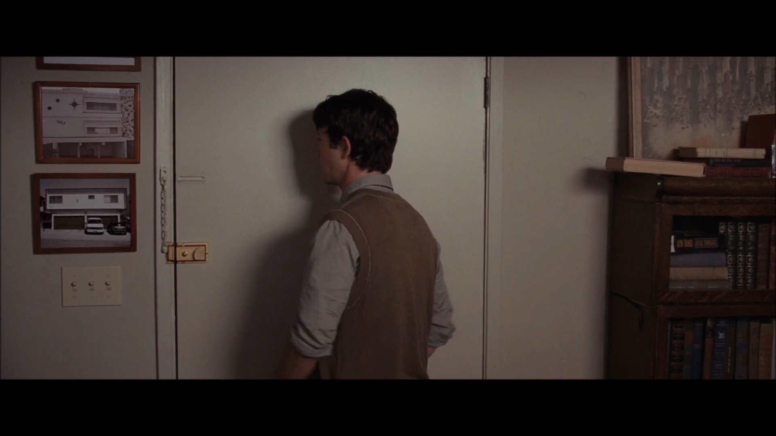

Slide 6
In this video clip there was low level of behavioral synchrony: the figures were not attentive to each other, the messages were not understood and both figures were not coordinated in physical and facial gestures and cues.

Slide 7
Let’s watch another video clip:

Slide 8
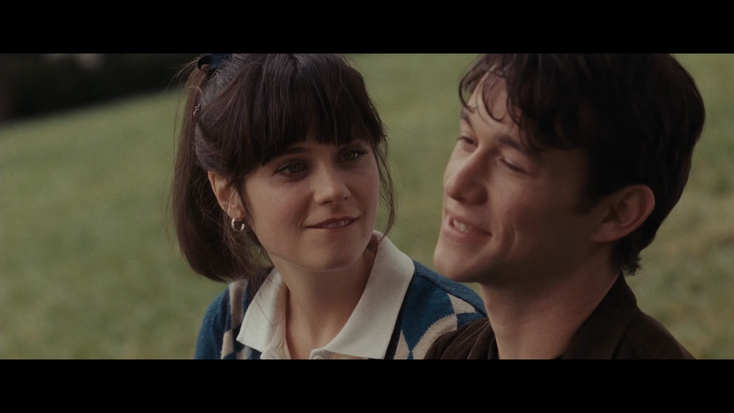

Slide 9
Please rate the overall level of behavioral synchrony in this video clip:

Slide 10
Let’s watch another video clip:

Slide 11
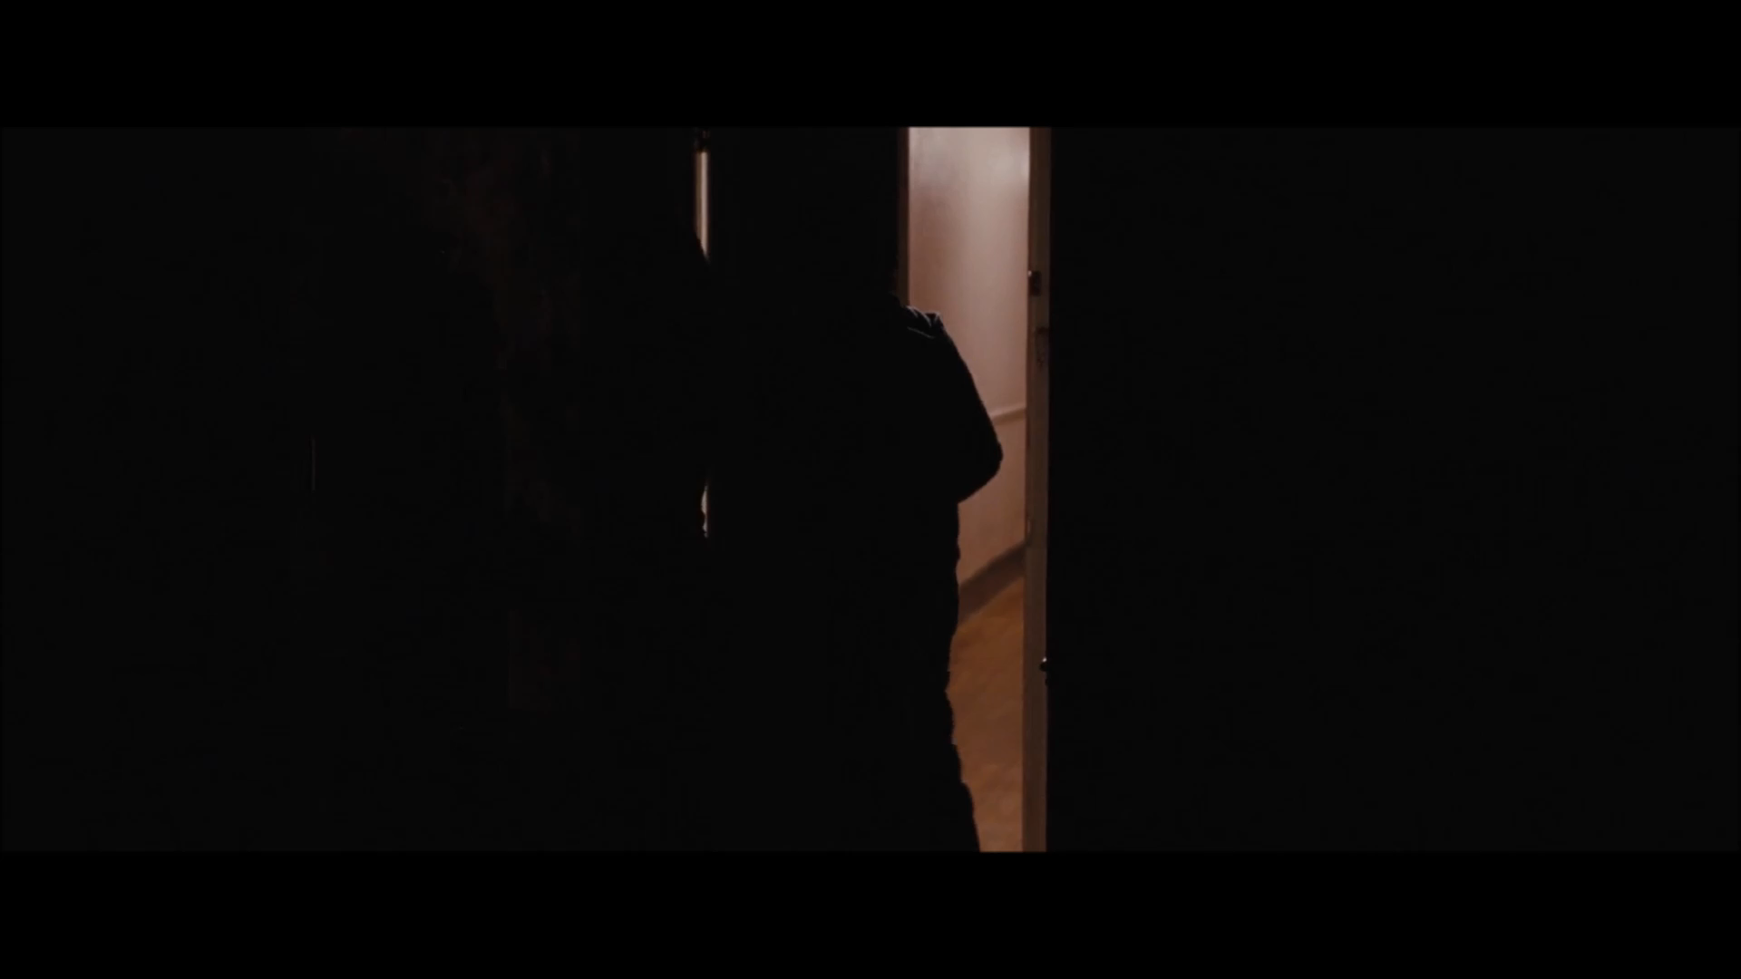

Slide 12
Please rate the overall level of behavioral synchrony in this video clip:

Slide 13
Please use the slider to freely rate the level of behavioral synchrony between the figures on the movies as you experience and understand for every single moment.
In case there are more than two figures on screen, rate the overall level of behavioral synchrony in the situation, as you understand it.
If there are no figures on screen, please move the slider to the left end (no synchrony at all)

